Slide 1


Slide 2
O - Obstacle Avoiding B - Bluetooth Control H - Human Following
Robot
Presented By:
Adison Giri Hawana Tamang
Kushal Pathak

Slide 3
Table of Contents
Introduction
Objectives
Features
Hardware Specification
Problems & Solution
Applications
Future Prospects
Conclusion

Slide 4
Introduction
An Arduino Bluetooth control uses Arduino microcontroller as its main control system for controlling a device, such as a robot, using a Bluetooth connection to send commands wirelessly.
Human following is a type of behaviour in which a robot follows a person as they move.
Such a robot could have a variety of practical applications, such as assisting people with mobility issues, serving as a personal assistant, or being used in entertainment or education.

Slide 5
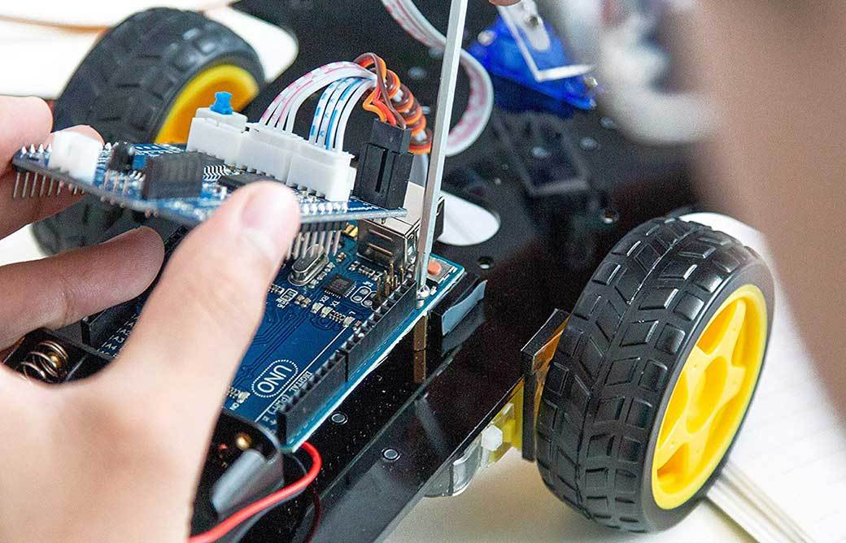
Introduction to Hardware Specification

Slide 6
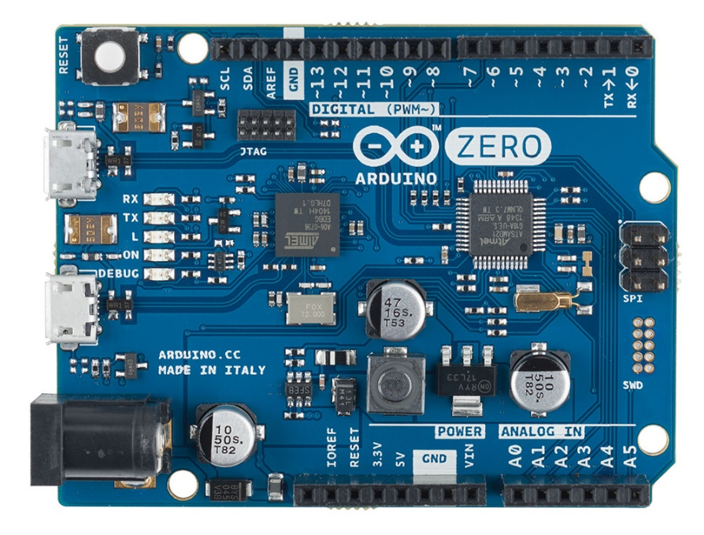
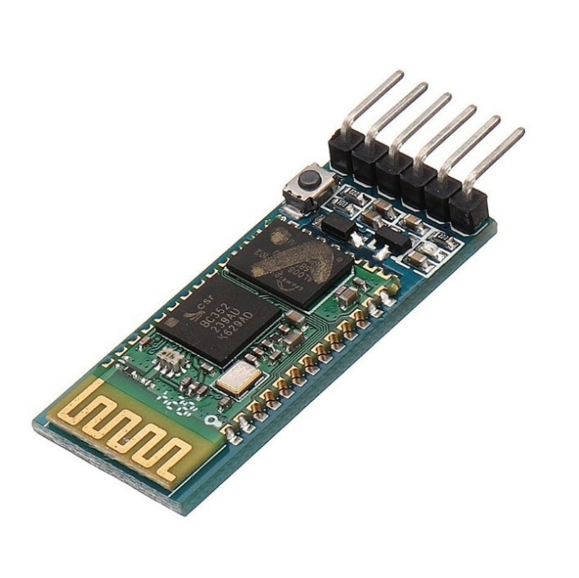
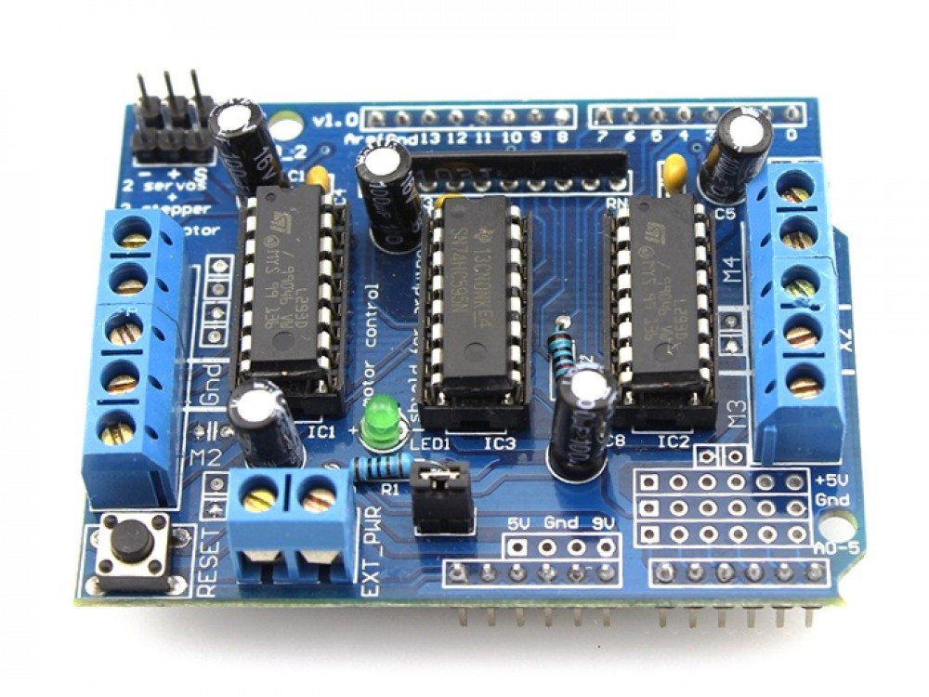
Hardware Used in Our project
Arduino Uno
Bluetooth Module
Motor Shield

Slide 7

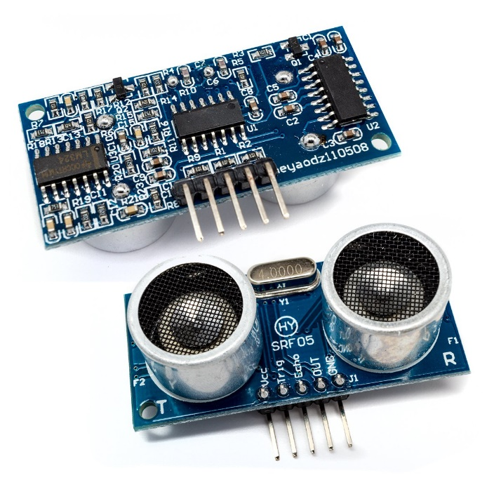
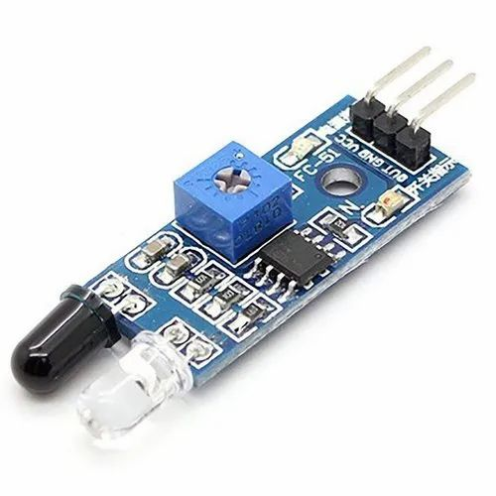
Hardware Used in Our project
Servo Motor
Ultrasonic Sensor
IR Sensor

Slide 8
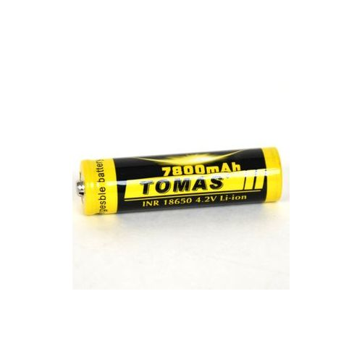
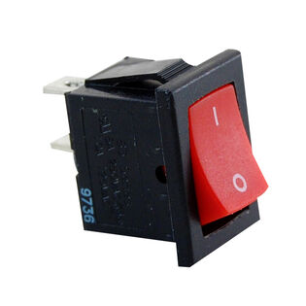
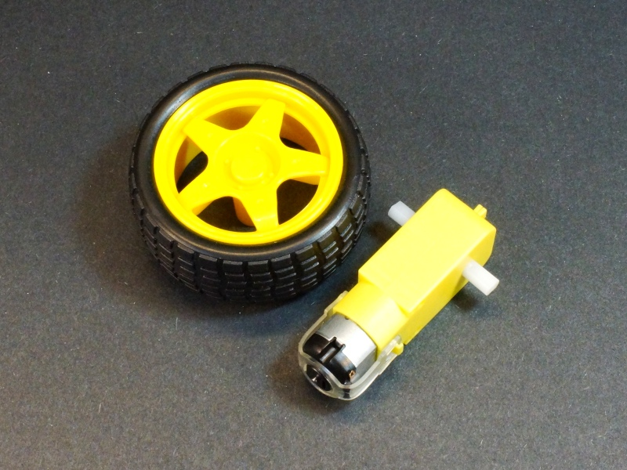
Hardware Used in Our project
DC Motor and Wheel
7800 Mah battery
Switch

Slide 9

Objectives of Bluetooth Control Arduino Robot

Slide 10
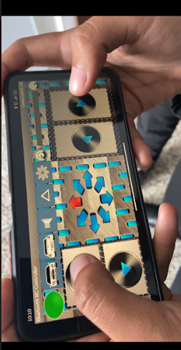
To provide a wireless method
1
To enable remote control of the robot
2
To allow for greater flexibility in controlling
3
To make the robot more accessible to users
4

Slide 11
Features of Bluetooth Control
Wireless Control
SmartPhone Compatibility
Lower Power Simulation
Flexibility

Slide 12
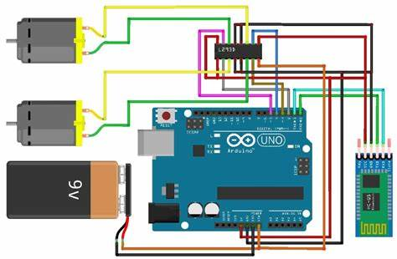

Slide 13

Objectives of Human Following
Robot

Slide 14
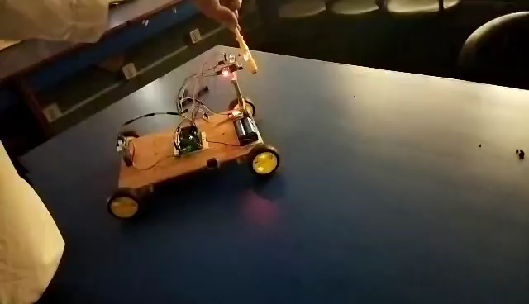
To create a robot that can autonomously follow.
To advance the field of robotics and create new possibilities for human-robot interaction.
To develop a system that uses sensors and programming
To provide a practical application for a robot with human following capabilities
1
2
3
4

Slide 15
1
Autonomous Tracking
2
Real Time Tracking
3
Obstacle Detection
4
Navigation Capabilities
5
Versatility
Features of Human Following Robot

Slide 16
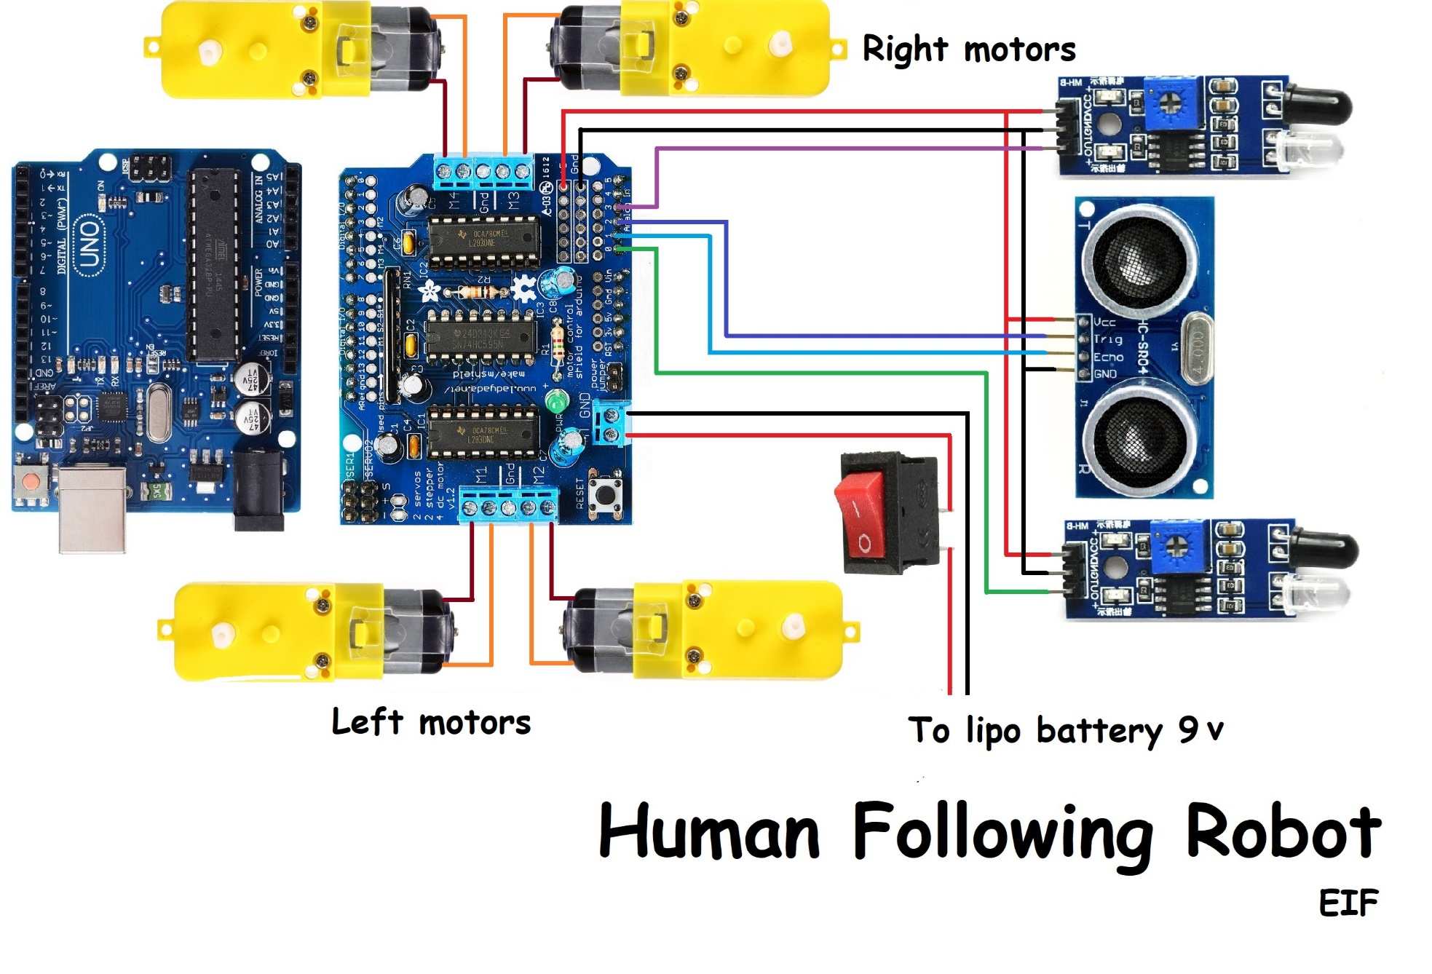

Slide 17
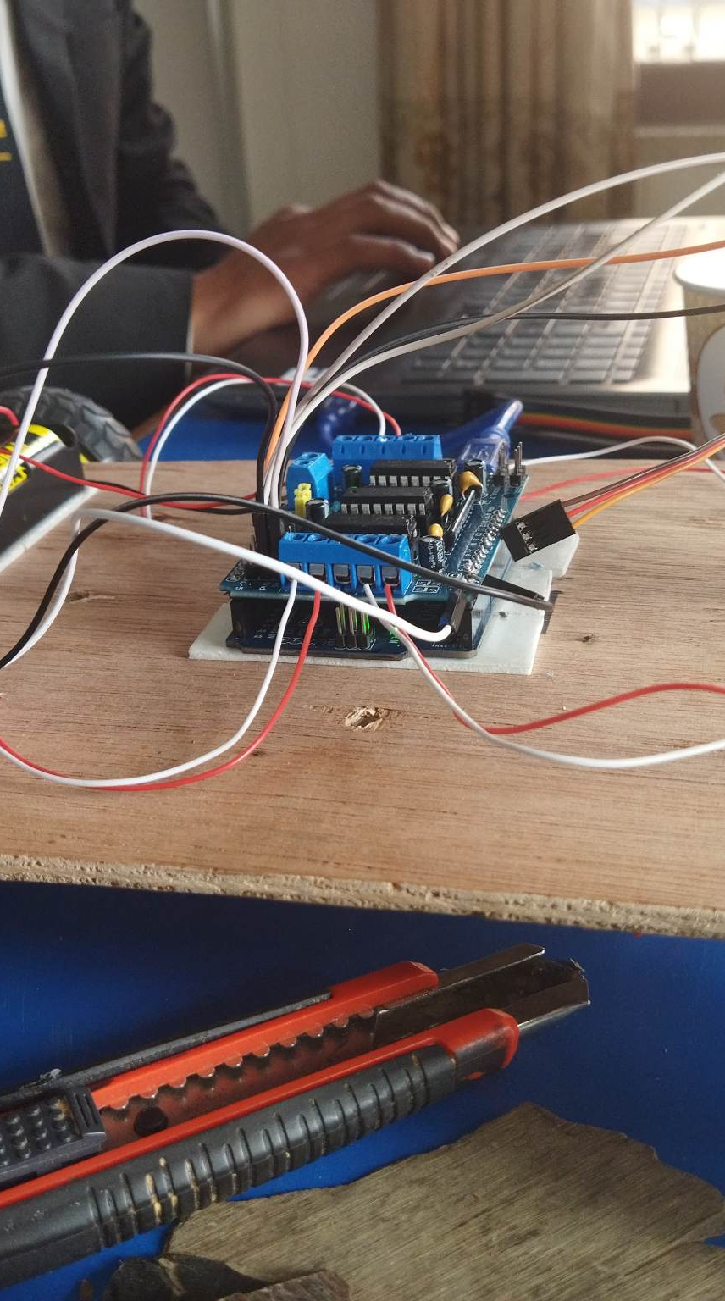
Problem & Solutions
Limited Range of Control
Potential for wire tangling
Inconvenient control
Lack of autonomy
Power Issue

Slide 18
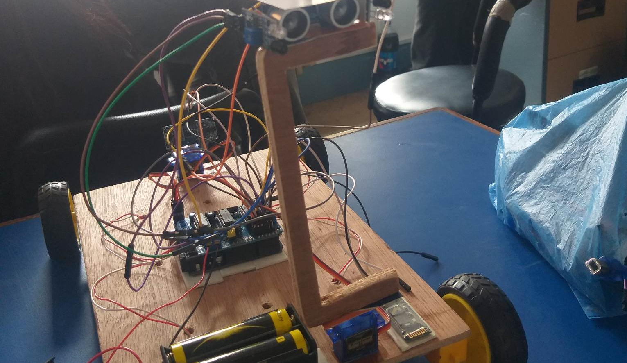
Solutions

Slide 19
Solutions
Limited range of control and wire tangling.
Development of smartphone app.
Assistance to people with mobility issues.
Ensure battery charging and power.
Additional features such as speech recognition and natural language processing.

Slide 20
Application of Bluetooth
Home Automation
Robotics
Education

Slide 21
Application of Human
Health Care
Personal Assistant
Entertainment
Industrial Automation

Slide 22
Future Prospects
Integration with other technologies
Enhanced Security
Increased Automation
Improvised Navigation
Enhanced sensor capabilities
Integration with other technologies

Slide 23
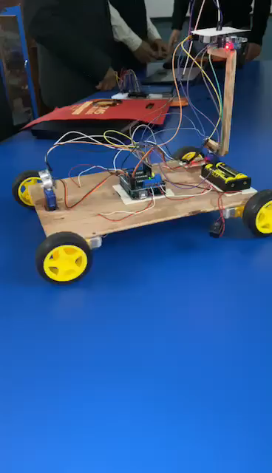
Conclusion
In conclusion, Bluetooth Control Arduino Robot and Human Following Arduino Robot are two technologies that have significant potential for further enhancements improving the functionality and versatility of robotic systems and increased functionality in various applications.

